Slide 1
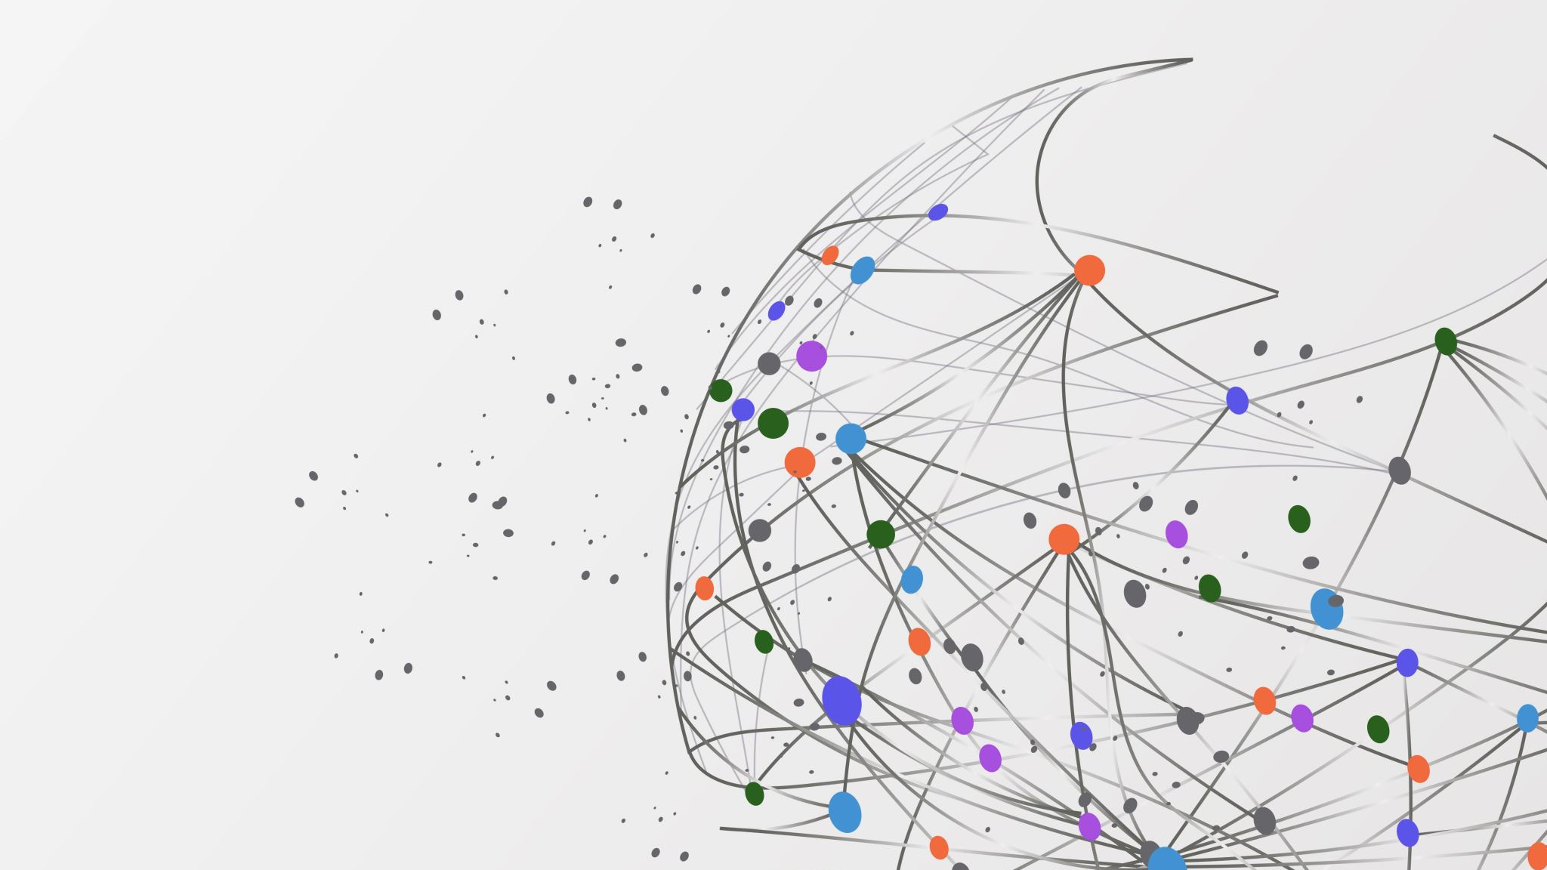
Introduction to Computational Drug Discovery Project
Name: Soham Desai
Major: Information Technology
Introduction: I am a Master’s student in Information Technology at Arizona State University with a 4.0 GPA. My experience spans roles in DevOps, business operations, and data analysis. Currently, I am a Business Operations Analyst at ASU College of Health Solutions, focusing on data management and policy development. Previously, I interned at Blue Yonder as Operations intern and worked at Casepoint LLC as DevOps Enigneer, where I gained hands-on experience in DevOps and software engineering. I am passionate about leveraging technology to drive efficiency and innovation.

Slide 2
Project Objective and Aim
Develop a proof of concept (POC) for a Computational Drug Discovery project using a basic machine learning model.
Build a Basic Model: Utilize bioactivity data from the ChEMBL database to predict the biological activity of chemical compounds.
Core Steps Demonstration:
Data Retrieval: Access and retrieve bioactivity data.
Preprocessing: Clean and prepare data for analysis.
Feature Selection: Identify key features from the data.
Model Building: Create and evaluate a machine learning model.
Steps:
Install Libraries: Set up Python libraries for data handling and modeling.
Retrieve Data: Use ChEMBL web services to gather bioactivity data.
Preprocess Data: Clean and format data for modeling.
Build Model: Train and test a basic machine learning model (e.g., Decision Tree).
Evaluate Model: Assess model performance using metrics like Mean Squared Error (MSE).

Slide 3
POC Steps and Technical Aspects
Objective: Create a basic machine learning model to predict the biological activity of chemical compounds using data from the ChEMBL database.
Install Required Libraries:
Install libraries like chembl_webresource_client, scikit-learn, and pandas for data handling and modeling.
Retrieve Bioactivity Data:
Query ChEMBL to get data related to a specific biological target.
Data Preprocessing:
Clean the data by handling missing values and ensuring consistency for machine learning use.
Model Building:
Develop a Decision Tree Regressor model to predict bioactivity, splitting data into training and testing sets for evaluation.
Labelling
Labeling compounds as either being active, inactive or intermediate
Outcome: Demonstrates data retrieval, preprocessing, feature selection, and model building to predict compound effectiveness.

Slide 4
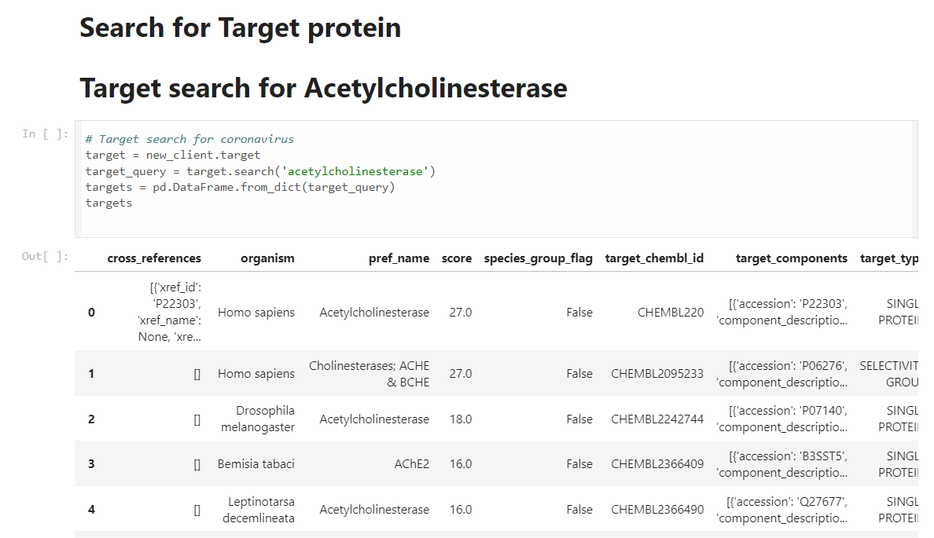
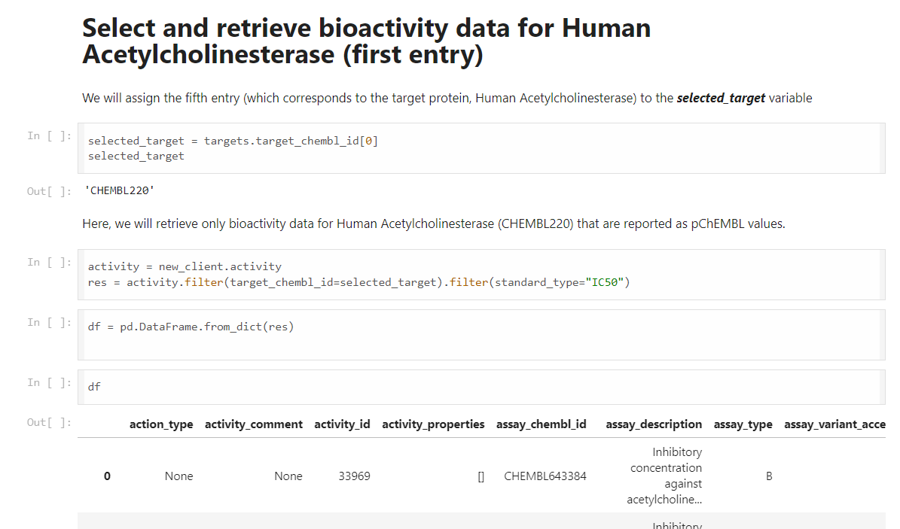
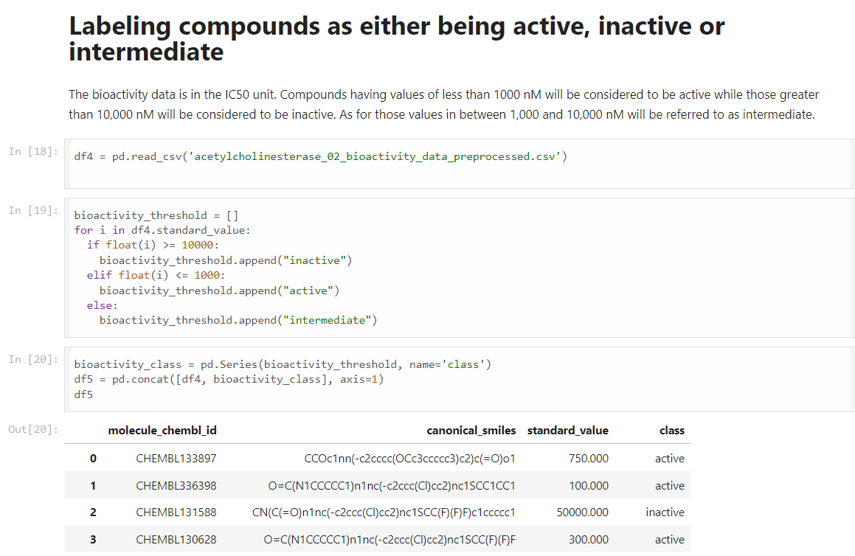
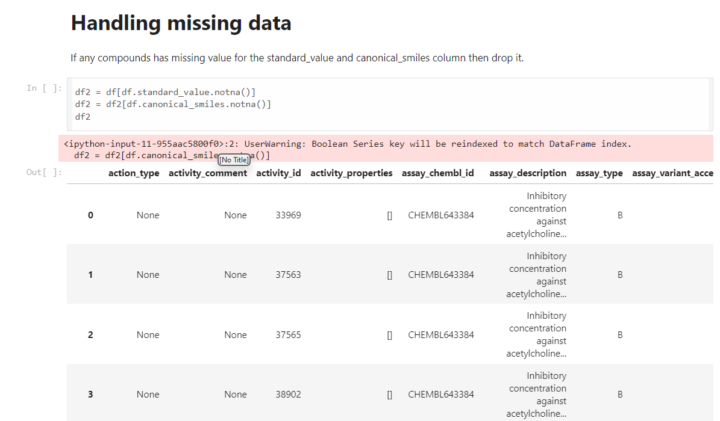

Slide 5
Demo Outcome and Significance
Outcome:
Successfully demonstrated retrieval, preprocessing, and modeling of bioactivity data.
Model showed reasonable accuracy in predicting biological activity, measured by Mean Squared Error (MSE).
Significance:
Validates the application of machine learning in drug discovery.
Provides a foundation for developing more advanced models and future applications in drug discovery.

Slide 6

Conclusion and Next Steps
Conclusion: The proof of concept demonstrates the viability of computational drug discovery using bioinformatics. It showcases how bioactivity data from the ChEMBL database can be leveraged to accelerate and refine drug development processes.
Next Steps:
Enhance Data Processing: Implement advanced data cleaning and feature engineering techniques.
Explore Advanced Models: Test more complex machine learning models, such as Random Forest and Neural Networks.
Integrate More Data: Incorporate additional datasets for a more thorough analysis.
Collaborate: Form partnerships with pharmaceutical companies to apply these methods in practical scenarios.

